Slide 2
About C-Prot
Operating globally since 2010, C-Prot develops unique cyber security products that solve users' cyber security problems with innovative methods, prioritize user experience (UX) and can be used on different platforms, addressing the global market.

Slide 3
Endpoint protection technology in the world
Slovakia
Romania
Belarus
Russian
Czech Republic
UK
USA
S. Korea
Türkiye
Japan
Chinese
Germany
Spain
Austria
Vietnamese
Italy
India

Slide 4
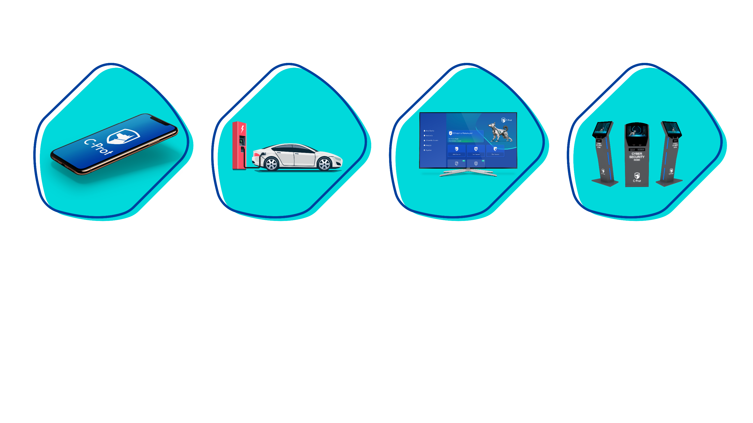
Protection Technology
C-Prot; It develops a wide range of advanced technology individual and corporate cyber security products, from smart televisions to smart cars, with support for 15 languages. In addition, it is one of 2 manufacturers in the field of Protection of Critical Facilities and Infrastructures, 7 manufacturers in the field of financial security, and one of the 3 manufacturers in the world in the field of Internet of Things (IoT) security.

Slide 5
C-Prot;
R&D activities in Turkey
Global operations from the UK office
continues.

Slide 6
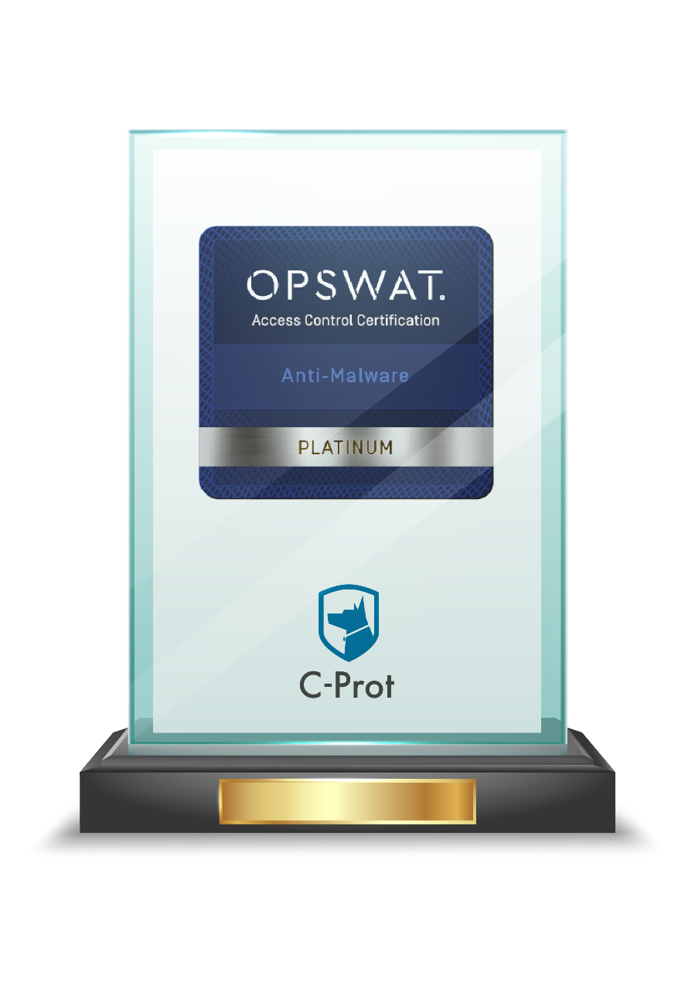
Awards and Certificates
C-Prot has the highest criteria OPSWAT Platinum certificate that few companies in the world have.

Slide 7
Awards and Certificates
C-Prot was awarded the "VB100" award for the 10th time with its individual and corporate products in the tests carried out by the UK-based independent testing and certification institution "Virus Bulletin" in the December-January period.
C-Prot once again proved its success in the international arena by obtaining the "VB100" certificates with a 100% detection rate. C-Prot has taken its place among the numbered companies in the world that have been awarded the "VB100" certificates.

Slide 8
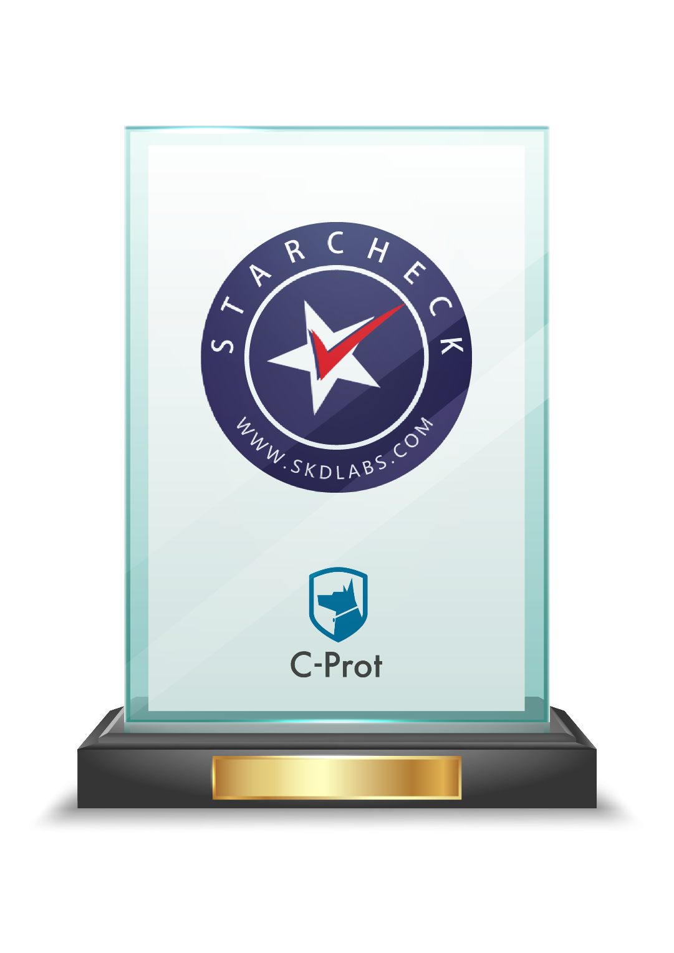
Awards and Certificates
C-Prot, which entered the test with its corporate and individual products; As a result of extensive tests carried out in 2022 by the independent testing and certification laboratory SKD Labs, it achieved 99.99% malware detection, 100% Ransomware detection and 0% false positive success rates, and was awarded the "STARCHECK" certificate for the 3rd.

Slide 9
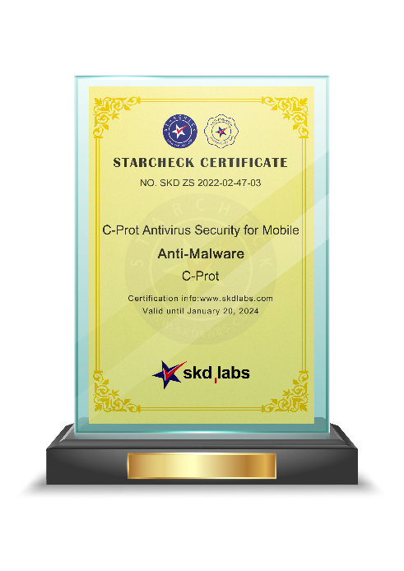
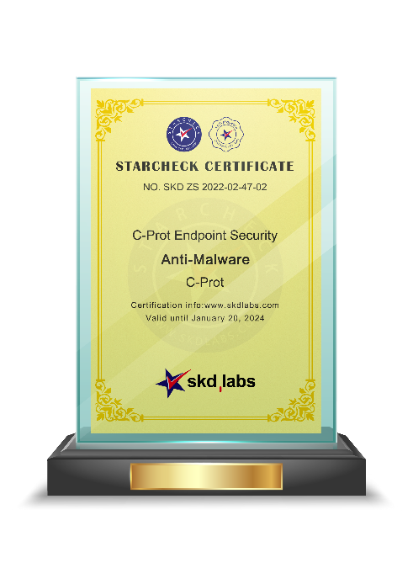
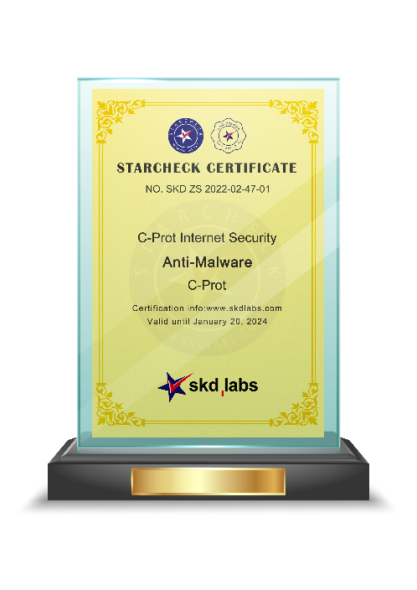
Awards and Certificates
C-Prot was deemed worthy of the “SKD AWARDS 2022 PRODUCT EXCELLENCE” awards in the individual and corporate endpoint protection categories.

Slide 10
Awards and Certificates
C-Prot is the first and only company in Turkey to receive the SKD AWARDS product excellence award in the individual, corporate and mobile endpoint protection categories for 3 consecutive years, and among the 5 companies globally.

Slide 11
World Wide Recognition
C-Prot is a member of the "Anti-Malware Testing Standards Organization" operating worldwide.
AMTSO is an international non-profit organization founded in 2008 to address a perceived need for improvement in the quality, relevance and objectivity of Anti-malware testing methodologies.

Slide 12
World Wide Recognition
C-Prot has become the only software company accepted from Turkey by the European Expert Group for IT-Security, which is based in Europe and operates globally. EICAR was founded in 1991 and provides an independent and neutral platform for IT-Security professionals in the field of science, research, development, implementation and management.

Slide 13
World Wide Recognition
C-Prot has become the only software company from Turkey accepted as a member of AVAR (Association of anti Virus Asia Researchers), which companies with global success can apply.
AVAR is an independent, non-profit, global organization founded in 1998 to prevent the spread and damage of malware. AVAR focuses on the Asia Pacific region, collaborating with leading experts from 18 countries including Australia, China, Hong Kong, India, Israel, Japan, Korea, Philippines, Singapore, Taiwan, Turkey, the United Kingdom and the United States continues its work.

Slide 14
CYBER SECURITY CLUSTER MEMBER
C-Prot is a member of the Turkey Cyber Security Cluster, which was established in 2017 with the participation of all relevant public institutions and organizations, private sector and academic representatives, supported by the Presidency of Defense Industries and the Presidency of the Digital Transformation Office, to develop the domestic cyber security ecosystem.
https://siberkume.org.tr/uyeler/

Slide 15
SAHA İstanbul ~ Defense, Aeronautics and Space Cluster
C-Prot in 2022; It has been accepted as a member of SAHA Istanbul ~ Defense, Aviation and Space Cluster, which creates a strong ecosystem by improving the technological and sectoral competencies of its members, supporting the cooperation between its members in order to increase the domesticity rate of the Turkish defense, aerospace and space industry and to move it to higher levels in international competition.

Slide 16
Reference
C-Prot develops a comprehensive solution that helps İşbank customers detect and prevent fraudulent attempts such as financial fraud and phishing via mobile and web channels.

Slide 17
+ 8 Million Users

Slide 18
C-Prot Embedded AppDefense
Advanced Security Solution for Mobile Apps

Slide 19
Increasing Need for Mobile Application Protection
ERMAC2.0 targeting more than 400 applications
The spyware vendor targeted users in Italy and Kazakhstan.
Dracarys Android Spyware used by Bitter APT
New variant of Sharkbot malware distributed through the Play Store
Harly Subscription Trojan distributed through Play Store
BRATA/AMEXTROLL evolves into Advanced Persistent Threat
SOVA malware detected with new functionalities.
Dracarys Android Spyware used by Bitter APT
Zanubis Bank Trojan Targets Peruvian Banks
PINE FLOWER Spyware using APT42 will target Iranian citizens
MobileOrder Spyware used by Scarlet Mimic to target the Uyghur community
Top ten Android malware attacks since April 2022

Slide 20
Increasing Need for Mobile Application Protection
COMMON TROJANS TARGETING THE FINANCIAL SECTOR
He observed that common trojans such as CRIL, BRATA, ERMAC, Hydra, SOVA and Sharkbot consistently target Android users.
The next figure shows the statistics of the most active banking trojan viruses according to the number of malicious applications observed in cyberspace.
Number of Samples

Slide 21
Increasing Need for Mobile Application Protection
As soon as an application is downloaded by the user on devices protected by C-Prot EAD, the Organization has full visibility of the EAD's protection status.
Outdated Android and iOS Devices
Rooted or Jailbroken Devices
Devices at risk of being rooted or jailbroken
Malware infected devices (includes Click Fraud, Chargeware, AppDropper, Backdoor, Bot, Spy, Trojan, Exploit, Surveillanceware, etc.)

Slide 22
Common Attack Types
Attacks focused on the working system of the application
Screen/Key loggers from the target application steal sensitive information.
Overlay attacks enable further attacks by tricking users into entering passwords or disabling security settings.
Accessibility attacks can act as a user and enter actions or press keys.

Slide 23
C-Prot Embedded AppDefense
C-Prot Embedded AppDefense is a Mobile Application Security SDK solution that allows application developers, security providers or mobile service providers to easily integrate it into their mobile applications and solutions.
For mobile app developers and financial services firms, we offer a cloud or on-prem based cybersecurity solution that anticipates, prevents, detects and responds to threats to mobile apps and helps them monitor threat factors happening on endpoints.

Slide 24
C-Prot Embedded AppDefense Highlights
SSL-Pinning
It determines whether the certificate is secure in communication with the server.
Anti-Keylogger
Detection of keylogger software that records every keystroke you make and monitors you continuously.
Device List
You can view the list of your devices, the operating system it uses, the IP information it uses while communicating, the brand and model.
Overlay Detection
With Overlay detection, C-Prot Embedded AppDefense detects if users have an overlay on their screen when using an application. Overlay attacks are used to intercept users' personal and financial data.

Slide 25
C-Prot Embedded AppDefense Highlights
Anti-Malware
Detection of malicious software on your device.
Device Fingerprinting
Generates a unique ID for your devices.
Central Management Console
Manage all your endpoints from anywhere with C-Prot Remote Administrator, available cloud-based or On-premise.
Root/Jailbreak Detection
It is determined whether the application works on a Root/Jailbroken device.

Slide 26
Mobile Application Security Overview
Static Analysis
Dynamic Analysis
Compound Call Graph
Malware
Assessment
Vulnerability
Assessment
Risk
Assessment
Reputation
Analysis
Binary Smilarity
Mobile Sensors
Web Crawlers
APP Store IP’sı
ACQUIRE
ANALYZE
PROTECT
50M+
APP ANALYZED
~7K+
APP/DAY CONVICTED
120K+
NEW APPS/DAY
23M+
SENSORS
180+
COUNTRIES

Slide 27
C-Prot provides the best protection
Threat detection and
prevention-oriented approach
Data Protection
focused approach
Intelligence on the global threat worldwide
system.
Protects against Zero-Day threats.
Blocks threats instantly with a heuristic scan engine.
Application protection
Unique device ID assignment
Provides secure financial transactions online
Blocks access to malicious and phishing websites
Threat Detection and
Prevention-Oriented Approach
Data Protection
focused approach

Slide 28
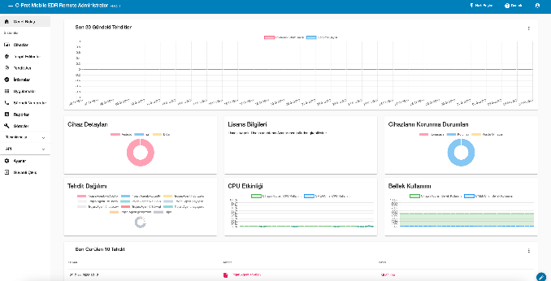
How Does C-Prot Embedded AppDefense Work?
First on-device Quick Scan
2
Rooted or Jailbroken?
Is there existing malware?
Fraud Risk Monitor and Reporting System
1
With API Key
Integrate the SDK.
C-Prot SDK
3
Advanced scanning-Behavioral Anomalies
-Root or Jailbreak Detection
-Malware Detection

Slide 29
C-Prot Application Operating Environment Overview
HIGH RISK: Jailbroken or Rooted Devices and Devices with Privilege Upgrade
Prevent him from logging in
MEDIUM RISK Devices with Root Enabling Software, Risky Software, Vulnerabilities, Trojans, etc.
Enable 2-Factor Authentication
C-Prot
SDK
LOW RISK Adware and Malware
Limit or prevent it from trading
HIGH RISK Using a Fake Keyboard During Authentication
Design a reliable user interface

Slide 30
Values provided by C-Prot
High Performance
Multi-layered Protection
Central Management
For large-scale networks where high performance is essential
C-Prot effectively manages network traffic with its distributed architecture. It also enables your endpoints to use system resources efficiently, allowing them to operate with high performance.
C-Prot uses the latest machine learning techniques to detect attacks on your endpoints. With features such as Vulnerability and Patch Management, it detects and automatically closes vulnerabilities in applications installed on your endpoints.
While offering cloud or on-prem management console alternatives, it enables efficient use of resources with high performance. You can easily manage a high number of clients, workstations, apply your policies and policies, create easy-to-use interactive dashboards and reports, and easily share your findings with your team and management.

Slide 31
cprot
C-Prot Global
C-Prot
cprottr
cprot

